Slide 1
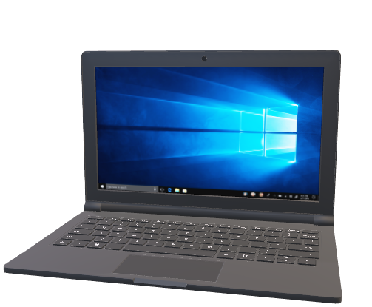

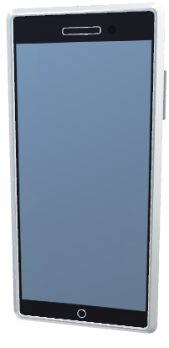
Xamarin Forms
View
(XAML)
ViewModel
(netstandard2.0)
Epoxy.Xamarin.Forms
Model
WPF
View
(XAML)
ViewModel
Epoxy.Wpf

